Slide 1

RA data issues

Slide 2

Agenda
What is wrong with our data
What is the suggestion about the issues
What is the action plan

Slide 3

What is wrong with our data
Issues of VAT
Correctly sales INC data, but the sales EXC data
Issues of cost
Falsely calculated of cost
Issues of date time
What sales data Ding Yong provided was by sale date time
What sales data financial department uses is by accounting date time
Confirm currently data in RA at the date time part
Issues of history data
Diff data between aggregation table and detail info table in history data
Issues of store modification
130024 had changed by Yu Xueming
Notes:
核对2013与2012年的历史数据。不考虑2011年的数据。

Slide 4
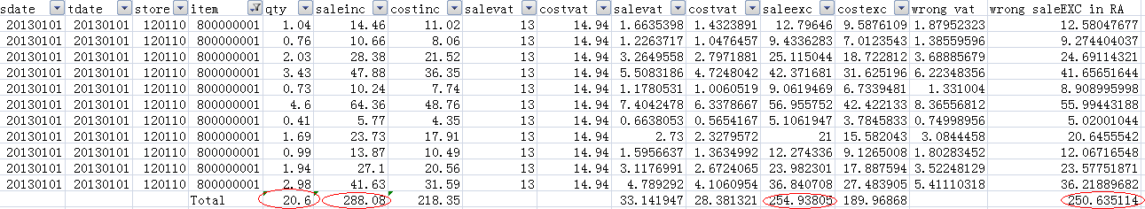
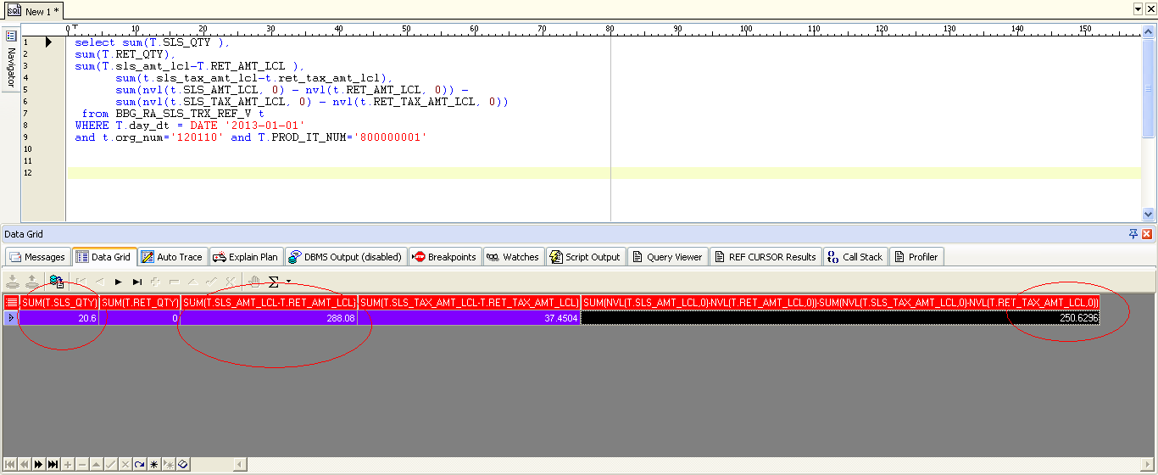
What is wrong with VAT
Sample data from WZ for one item in 120110 in 20130101
Sample data from RA
Error vat from Ding Yong
Notes:
核对2013与2012年的历史数据。不考虑2011年的数据。

Slide 5

What is the suggestion about the issues
Suggestion I: compare with each data, fix the error data
Advantage: Null
Disadvantage: Long time, Huge work
Suggestion II: delete the whole history data in RA month by month, and upload again carefully
Advantage: less time, easy to control
Disadvantage: Null

Slide 6
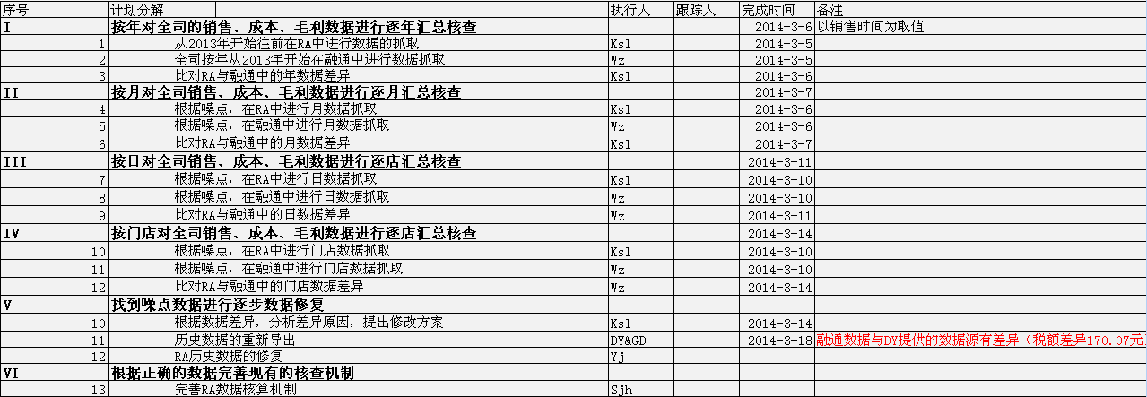

What is the action plan

Slide 7
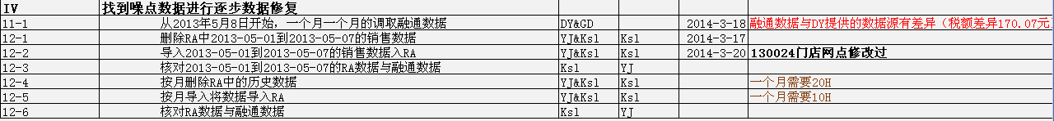

What is the action plan for IV

Slide 8
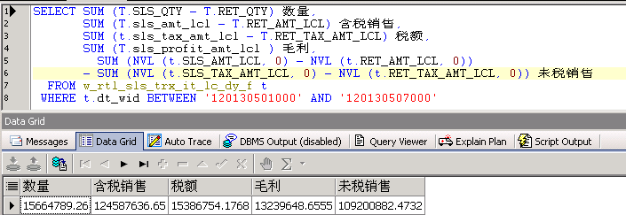
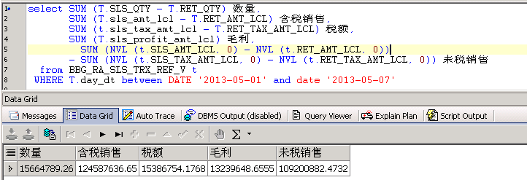
Checking Conclusion

Slide 9

Thank you

